Slide 1
Cryptography & Network Security ECS401
Mrs. Beena G Pillai
Asst. Professor,
Dept. of CSE.

Slide 2
Agenda of Today’s Session
Introduction
What is Cryptography?
Classification of Cryptography.
Cryptanalysis
Cryptographic Attacks
Security Services
Security Mechanisms

Slide 3
1. Introduction

Slide 4




2. What is Cryptography?
Hi Jo send me Rs. 10000 please.
Hi Jo, how are you?

Slide 5

Why Cryptography is important
Cryptography refers to set of techniques used to protect the integrity of networks, program and data from attack, damage or unauthorized access.

Slide 6
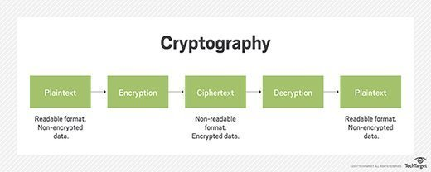

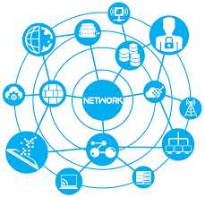



Hi, How are you?
34567843
34567843
Hi, How are you?

Slide 7
How Cryptography works?
34568798
Error / Original Text
Hi Jo, how are you?

Slide 8
3. Classification of Cryptography
Cryptography
Symmetric Key Cryptography
Classical Cryptography
Modern Cryptography
Asymmetric Key Cryptography
Substitution Cipher
Transposition Cipher
Block Cipher
Stream Cipher

Slide 9
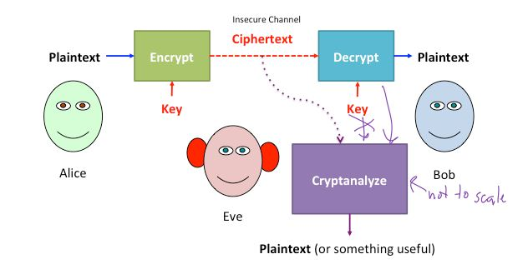
4. Cryptanalysis
The study of principles and methods of transforming an unintelligible message back into an intelligible message without knowledge of the key

Slide 10
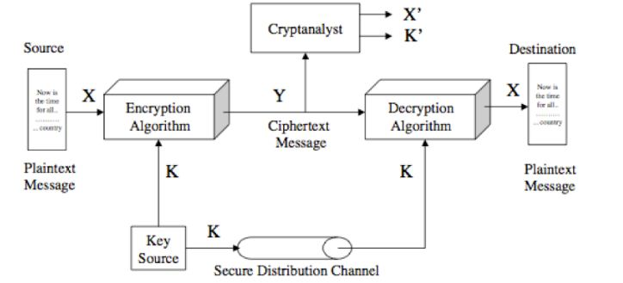
Cryptanalytic attacks Cipher text only – A copy of cipher text alone is known to the cryptanalyst. Known plaintext – The cryptanalyst has a copy of the cipher text and the corresponding plaintext. Chosen plaintext – The cryptanalysts gains temporary access to the encryption machine. They cannot open it to find the key, however; they can encrypt a large number of suitably chosen plaintexts and try to use the resulting cipher texts to deduce the key. Chosen cipher text – The cryptanalyst obtains temporary access to the decryption machine, uses it to decrypt several string of symbols, and tries to use the results to deduce the key

Slide 11
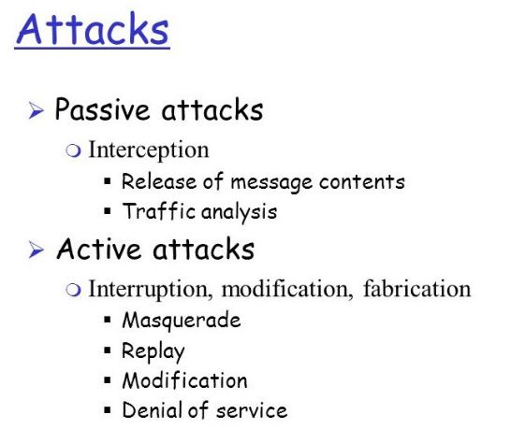
5. Cryptographic Attacks

Slide 12
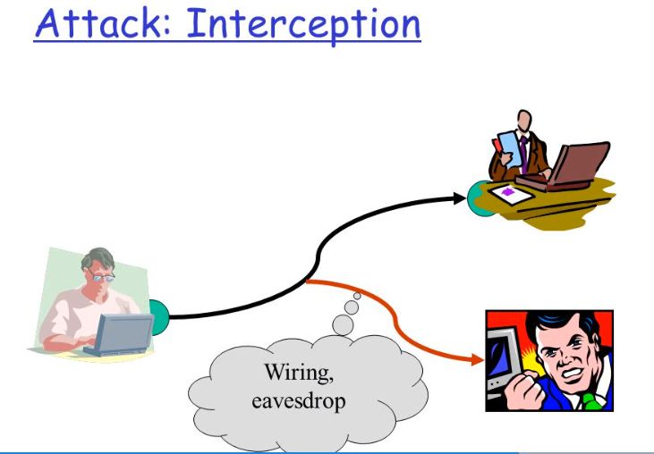
SECURITY ATTACKS
Interception
This is an attack on confidentiality.
An unauthorized party gains access to an asset.
Eg: wire tapping to capture data in the network, illicit copying of files

Slide 13
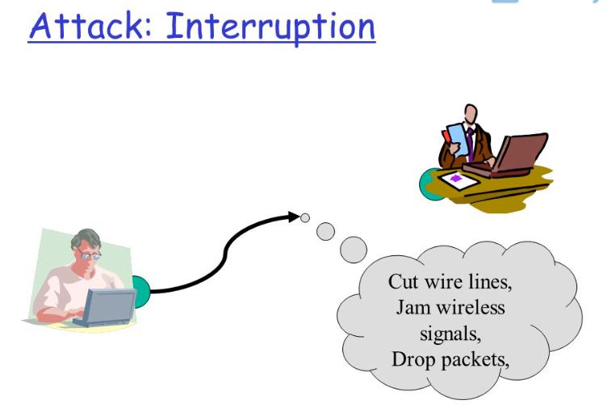
Interruption
This is an attack on availability.
An asset of the system is destroyed or becomes unavailable or unusable.
Eg : destruction of piece of hardware, cutting of a communication line

Slide 14
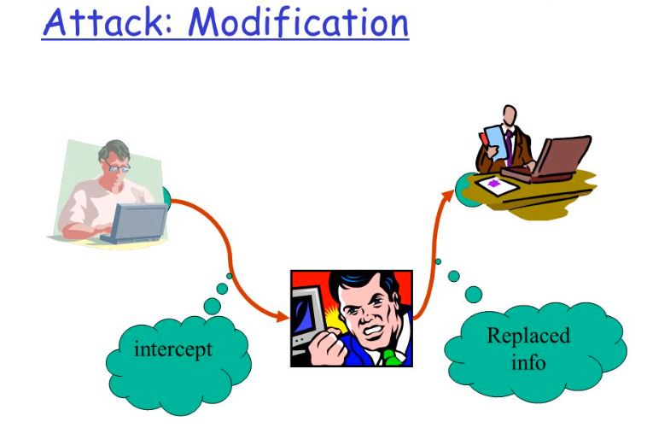
Modification
This is an attack on integrity.
An unauthorized party not only gains access to but tampers with an asset.
Eg: changing values in data file, altering a program, modifying the contents of messages being transmitted in a network.

Slide 15
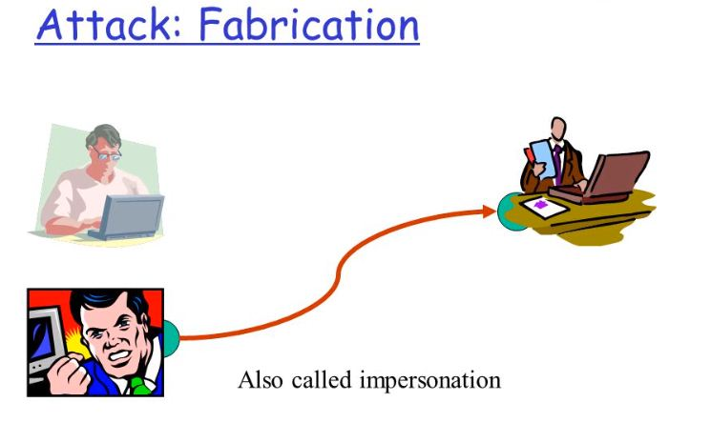
Fabrication
This is an attack on authenticity
An unauthorized party inserts counterfeit objects into the system
Eg: Insertion of spurious message in a network or addition of records to a file.

Slide 16
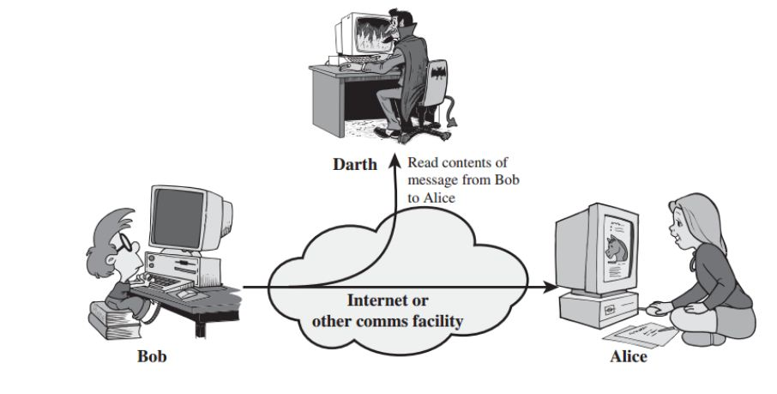
Passive Attacks : Passive attacks are in the nature of eavesdropping on, or monitoring of, transmissions.
Release of Message Contents.
A telephone conversation, an e-mail message and a transferred file may contain sensitive or confidential information.

Slide 17
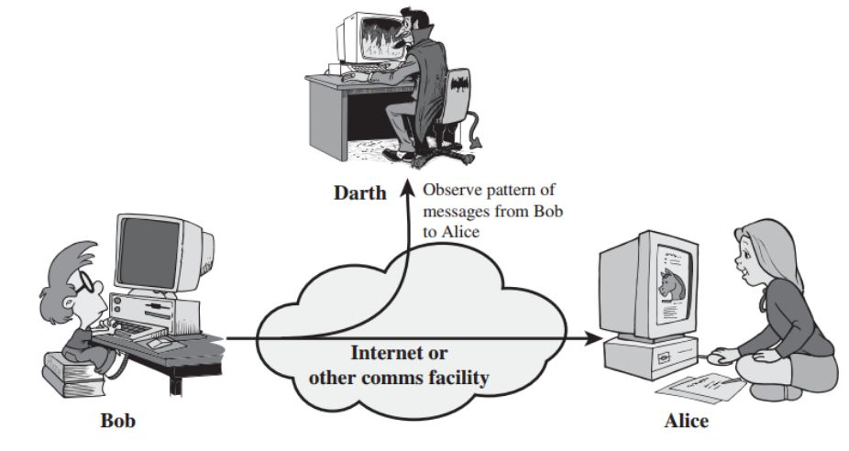
Traffic Analysis : Here, suppose we had a way of making the contents of messages or other information traffic so that opponents, event if they captured the message, could not extract the information from the message. The common technique for masking contents is encryption.

Slide 18
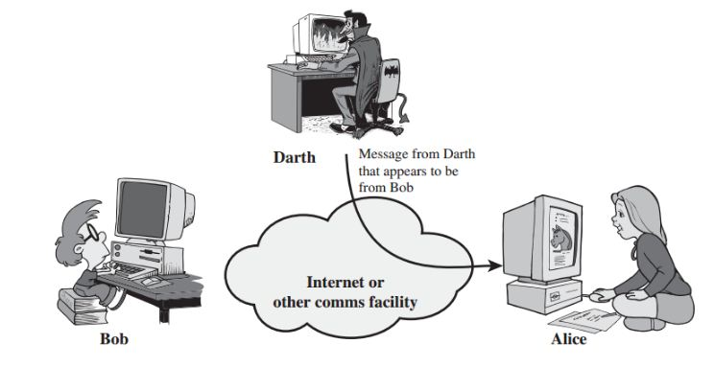
Active Attack: These attacks involve some modification of the data stream or the creation of a false stream.
Masquerade – One entity pretends to be a different entity.

Slide 19
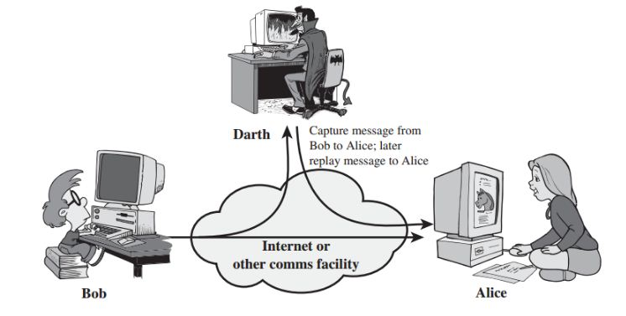
Replay – involves passive capture of a data unit and its subsequent transmission to produce an unauthorized effect.

Slide 20
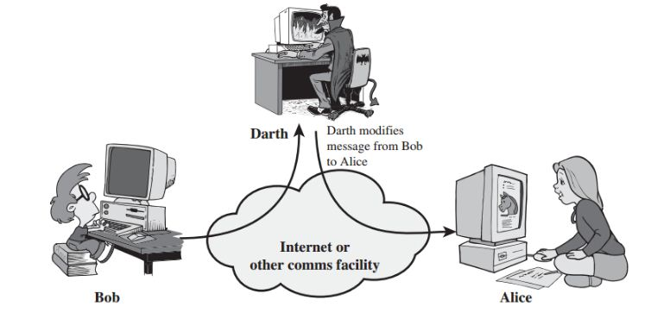
Modification of messages – Some portion of message is altered or the messages are delayed or recorded, to produce an unauthorized effect.

Slide 21
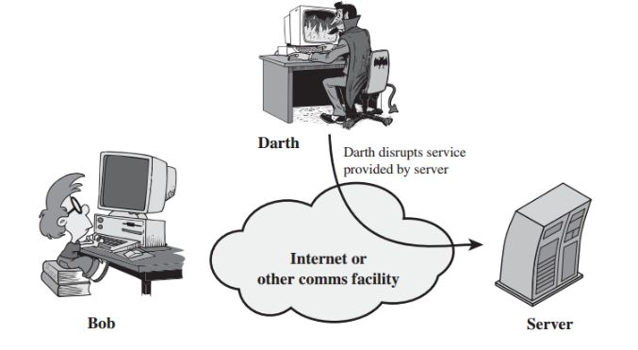
Denial of service – Prevents or inhibits the normal use or management of communication facilities. Another form of service denial is the disruption of an entire network, either by disabling the network or overloading it with messages so as to degrade performance.

Slide 22
6. SECURITY SERVICES (X.800)
Security Services | Security Mechanisms
Data Confidentiality | Encipherment and Routing Protocol
Data Integrity | Encipherment, digital signature and data integrity
Authentication | Encipherment, digital signature and authentication exchange
Non repudiation | Digital signature, data integrity and notarization
Access Control | Access control mechanism.

Slide 23
Security Services
Messages
Confidentiality
Integrity
Entity
Authentication
Authentication
Non repudiation
Access control
Availability

Slide 24
1. Data Confidentiality:
Ensures that the information in a computer system a n d transmitted information are accessible only for reading by authorized parties.
E.g. Printing, displaying and other forms of disclosure.
2. Integrity:
Ensures that only authorized parties are able to modify computer system assets and transmitted information.
Modification includes writing, changing status, deleting, creating and delaying or replaying of transmitted messages.

Slide 25
3. Authentication:
Ensures that the origin of a message or electronic document is correctly identified, with an assurance that the identity is not false.
4. Non repudiation:
Requires that neither the sender nor the receiver of a message be able to deny the transmission.
5. Access control:
Requires that access to information resources may be controlled by or the target system.
6. Availability:
Requires that computer system assets be available to authorized parties when needed.

Slide 26
6. Security Mechanisms
Feature designed to detect, prevent or recover from a security attack.
Security Mechanisms
Pervasive Security Mechanisms
(5 Types)
Specific Security Mechanisms
(8 Types)

Slide 27
Specific Security Mechanisms
Encipherment
Digital Signature
Access Control
Data Integrity
Traffic Padding
Authentication Exchange
Notarization
Routing Control

Slide 28
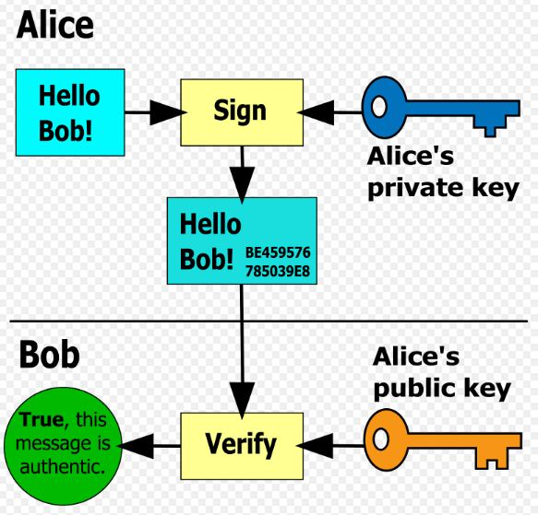
Encipherment
The use of mathematical algorithms to transform data into a form that is not readily intelligible. The transformation and subsequent recovery of the data depend on an algorithm and zero or more encryption keys.
Digital Signature
Data appended to, or a cryptographic transformation of a data unit that allows a recipient of the data unit to prove the source and integrity of the data unit and protect against forgery (e.g., by the recipient).

Slide 29

Access Control
A variety of mechanisms that enforce access rights to resources.
Data Integrity
A variety of mechanisms used to assure the integrity of a data unit or stream of data units.
Data Integrity
Truthful
Complete
Retrievable
Verifiable
Accurate

Slide 30
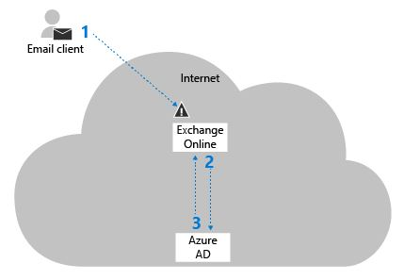
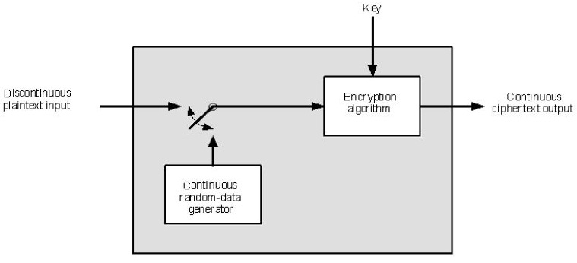
Authentication Exchange
A mechanism intended to ensure the identity of an entity by means of information exchange.
Traffic Padding
The insertion of bits into gaps in a data stream to frustrate traffic analysis attempts.

Slide 31
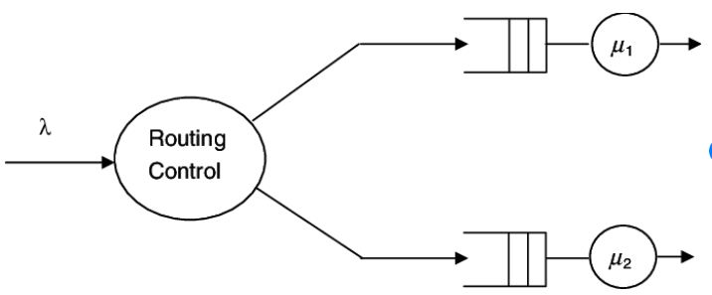

Routing Control
Enables selection of particular physically secure routes for certain data and allows routing changes, especially when a breach of security is suspected.
Notarization
The use of a trusted third party to assure certain properties of a data exchange.

Slide 32
Pervasive Security Mechanisms
Trusted Functionality
That which is perceived to be correct with respect to some criteria (e.g., as established by a security policy).
Security Label
The marking bound to a resource (which may be a data unit) that names or designates the security attributes of that resource.
Event Detection
Detection of security-relevant events.
Security Audit Trail
Data collected and potentially used to facilitate a security audit, which is an independent review and examination of system records and activities.
Security Recovery
Deals with requests from mechanisms, such as event handling and management functions, and takes recovery actions.

Slide 33
Thank you!

